Slide 1
Probabilistic Modeling of Data: The Basics
CS771: Introduction to Machine Learning
Piyush Rai

Slide 2
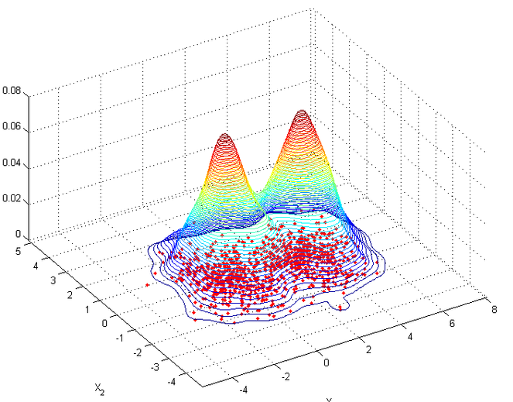
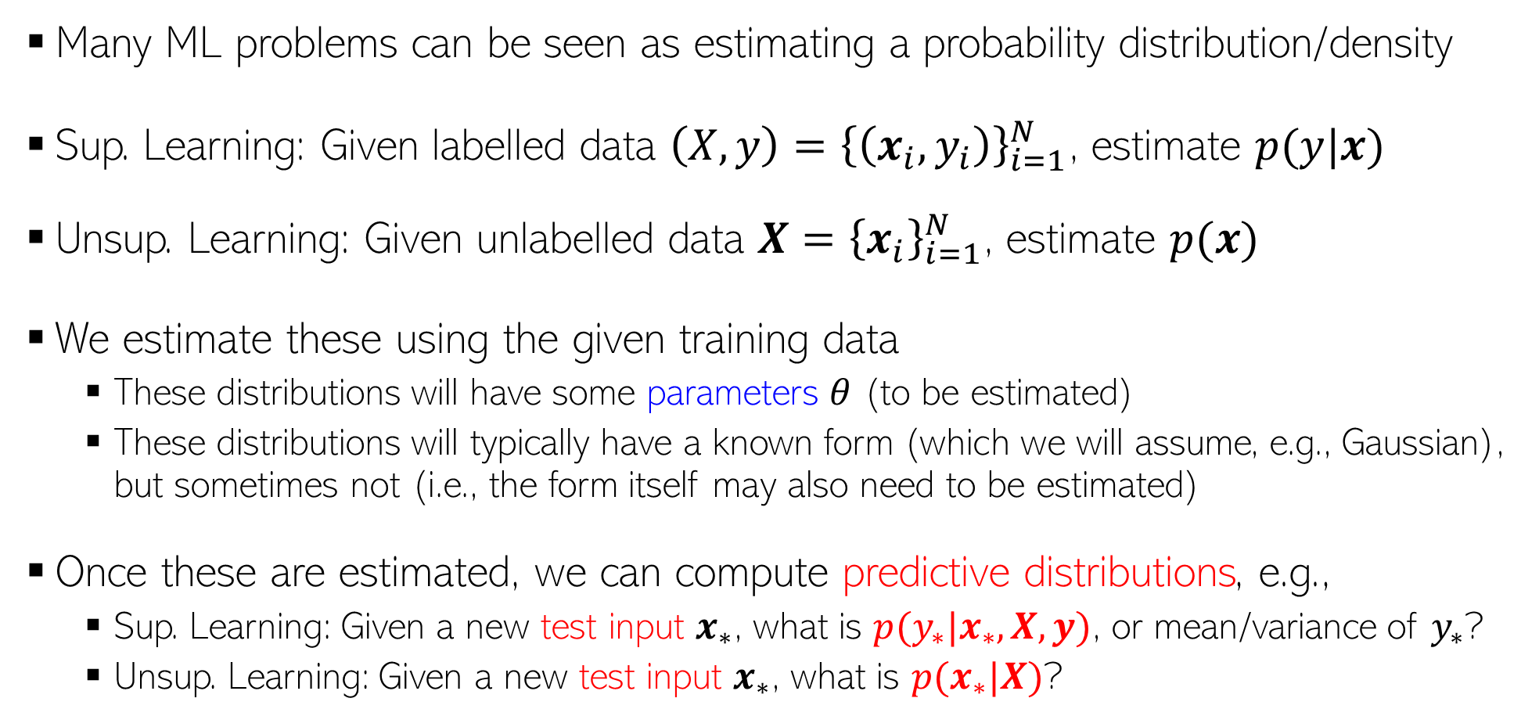
The Probabilistic Approach to ML
Many ML problems can be seen as estimating a probability distribution/density
Sup. Learning: Given labelled data ${\left(X,y\right)=\left\{\left(x_{i}, y_{i}\right)\right\}}_{i=1}^{N}$, estimate $p(y|x)$
Unsup. Learning: Given unlabelled data ${X=\left\{x_{i}\right\}}_{i=1}^{N}$, estimate $p(x)$
We estimate these using the given training data
These distributions will have some parameters $θ$ (to be estimated)
These distributions will typically have a known form (which we will assume, e.g., Gaussian), but sometimes not (i.e., the form itself may also need to be estimated)
Once these are estimated, we can compute predictive distributions, e.g.,
Sup. Learning: Given a new test input $x_{∗}$, what is $p(y_{∗}|x_{∗},X,y)$, or mean/variance of $y_{∗}$?
Unsup. Learning: Given a new test input $x_{∗}$, what is $p(x_{∗}|X)$?
p(y=green|x)
p(y=red|x)
Distribution of test data conditioned on the training data and any other relevant quantities

Slide 3

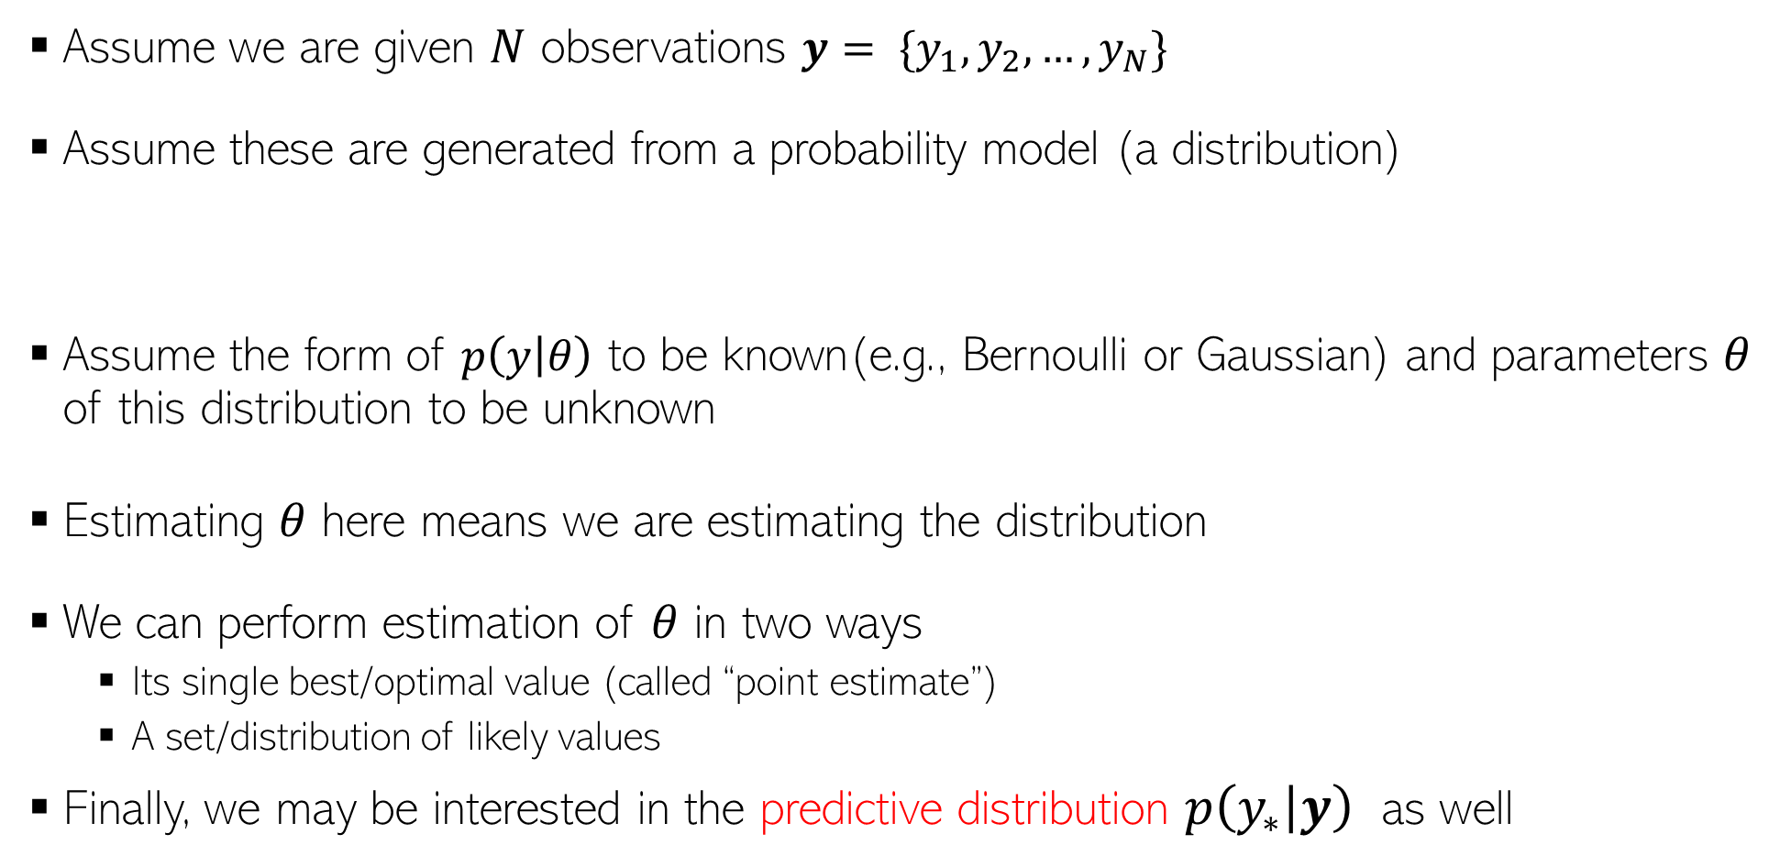



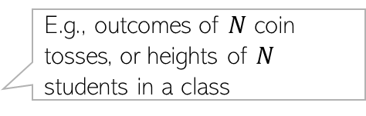
Getting Started: A Simple Setting
E.g., outcomes of $N$ coin tosses, or heights of $N$ students in a class
Assume we are given $N$ observations $y= \{y_{1},y_{2},…,y_{N}\}$
Assume these are generated from a probability model (a distribution)
Assume the form of $p\left(y | θ\right)$ to be known(e.g., Bernoulli or Gaussian) and parameters $θ$ of this distribution to be unknown
Estimating $θ$ here means we are estimating the distribution
We can perform estimation of $θ$ in two ways
Its single best/optimal value (called “point estimate”)
A set/distribution of likely values
Finally, we may be interested in the predictive distribution $p\left(y_{∗} | y\right)$ as well
$y_{n}∼p\left(y | θ\right) ∀n$
$$\text{(}\text{assumed} \text{independently}\text{ \& }\text{identically} \text{distributed}\text{ (}\text{i}\text{.}\text{i}\text{.}\text{d}\text{.)}\text{)}$$
Such a diagram is called a plate diagram
$$θ$$
Shaded nodes mean the value of the variable is observed, white node means the value is unobserved
$$y_{n}$$
$$N$$
New test observation

Slide 4

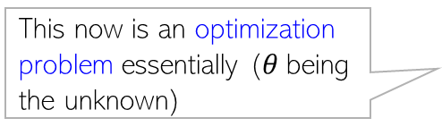


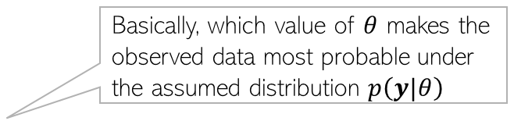


Parameter Estimation in Probabilistic Models
Since data is assumed to be i.i.d., we can write down its total probability as
$p\left(y|θ\right)$ called “likelihood” - probability of observed data as a function of params $θ$
We wish to find the “best” $θ,$ given observed data $y$
One notion of “best” is to find $θ$ which maximizes the likelihood
$p\left(y|θ\right)=p\left(y_{1},y_{2},…,y_{N} | θ\right)$ $= \prod_{n=1}^{N}{p(y_{n}|θ)}$
Basically, which value of $θ$ makes the observed data most probable under the assumed distribution $p\left(y|θ\right)$
$$p\left(y|θ\right)$$
This now is an optimization problem essentially ($θ$being the unknown)
$$θ_{opt}=θ_{MLE}$$
$$θ$$

Slide 5
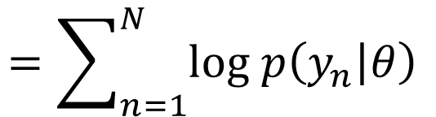
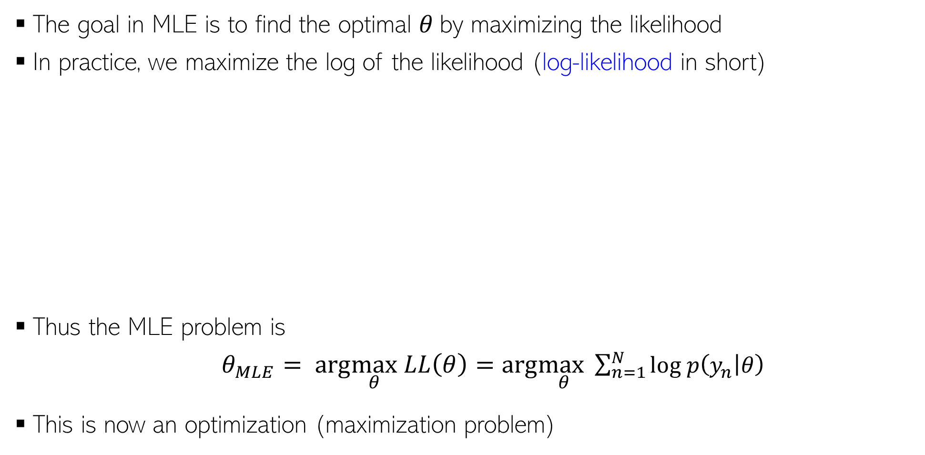
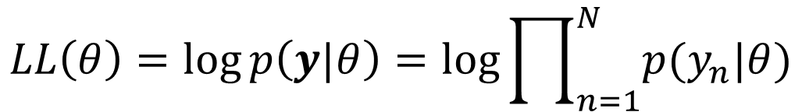



Maximum Likelihood Estimation (MLE)
The goal in MLE is to find the optimal $θ$by maximizing the likelihood
In practice, we maximize the log of the likelihood (log-likelihood in short)
Thus the MLE problem is
$θ_{MLE}= arg\max_{θ} LL\left(θ\right)=arg\max_{θ}\sum_{n=1}^{N}{log p\left(y_{n} | θ\right) }$
This is now an optimization (maximization problem)
Leads to simpler algebra/calculus, and also yields better numerical stability when implementing it on computer (dealing with log of probabilities)
Taking log doesn’t affect the optima since log is a monotonic function
$$log p\left(y|θ\right)$$
$$LL\left(θ\right)=\log{p\left(y|θ\right)}=log\prod_{n=1}^{N}{p(y_{n}|θ)}$$
$$=\sum_{n=1}^{N}{log p\left(y_{n} | θ\right) }$$
$$θ_{opt}=θ_{MLE}$$
$$θ$$

Slide 6

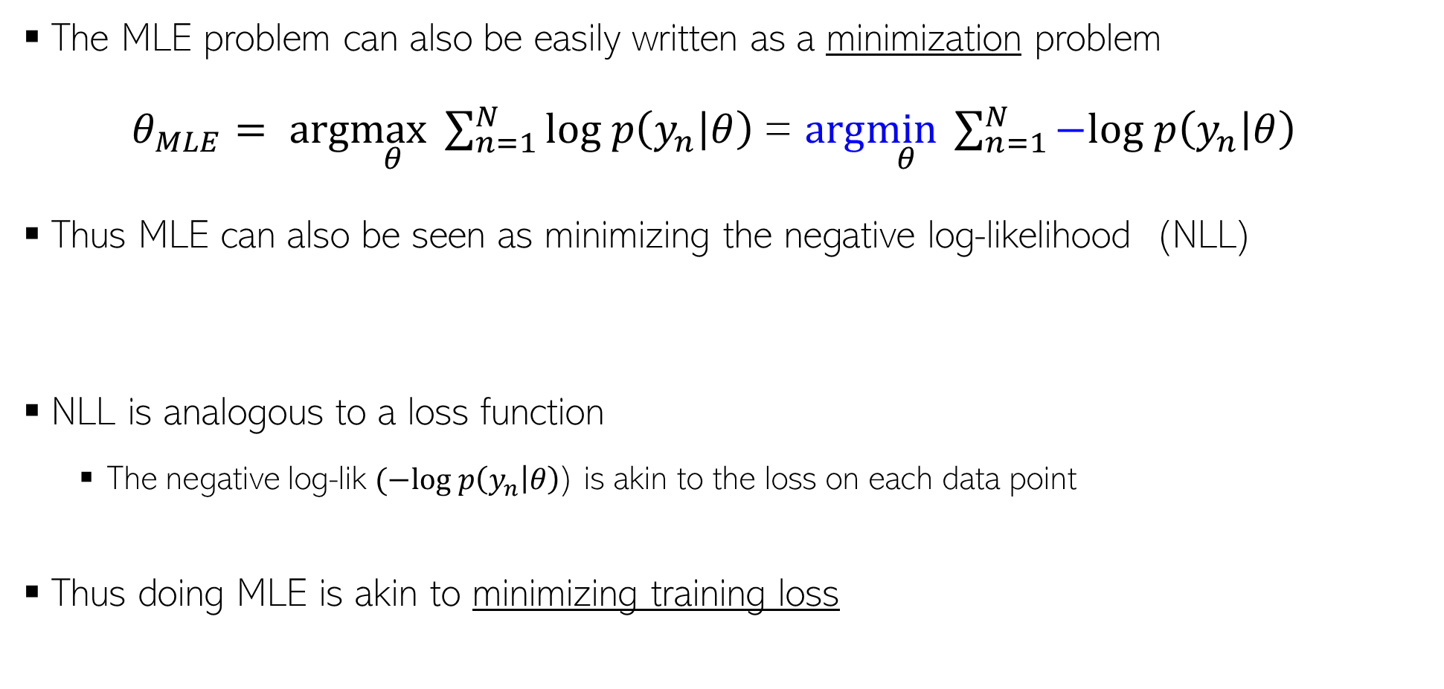
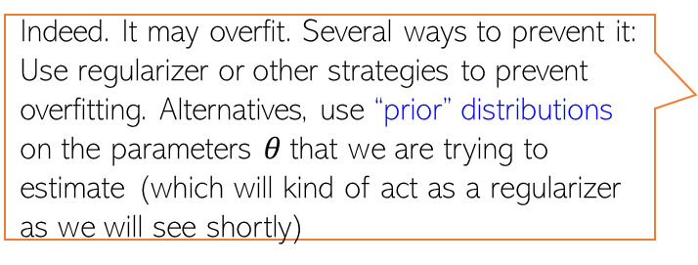

Maximum Likelihood Estimation (MLE)
Negative Log-Likelihood
(NLL)
The MLE problem can also be easily written as a minimization problem
$θ_{MLE}= arg\max_{θ}\sum_{n=1}^{N}{log p\left(y_{n} | θ\right) }$= $arg\min_{θ}\sum_{n=1}^{N}{−log p\left(y_{n} | θ\right) }$
Thus MLE can also be seen as minimizing the negative log-likelihood (NLL)
NLL is analogous to a loss function
The negative log-lik $(−log p\left(y_{n} | θ\right)$) is akin to the loss on each data point
Thus doing MLE is akin to minimizing training loss
Indeed. It may overfit. Several ways to prevent it: Use regularizer or other strategies to prevent overfitting. Alternatives, use “prior” distributions on the parameters $θ$that we are trying to estimate (which will kind of act as a regularizer as we will see shortly)
$θ_{MLE}=arg\min_{θ}$ $NLL(θ)$
Such priors have various other benefits as we will see later
Does it mean MLE could overfit? If so, how to prevent this?

Slide 7
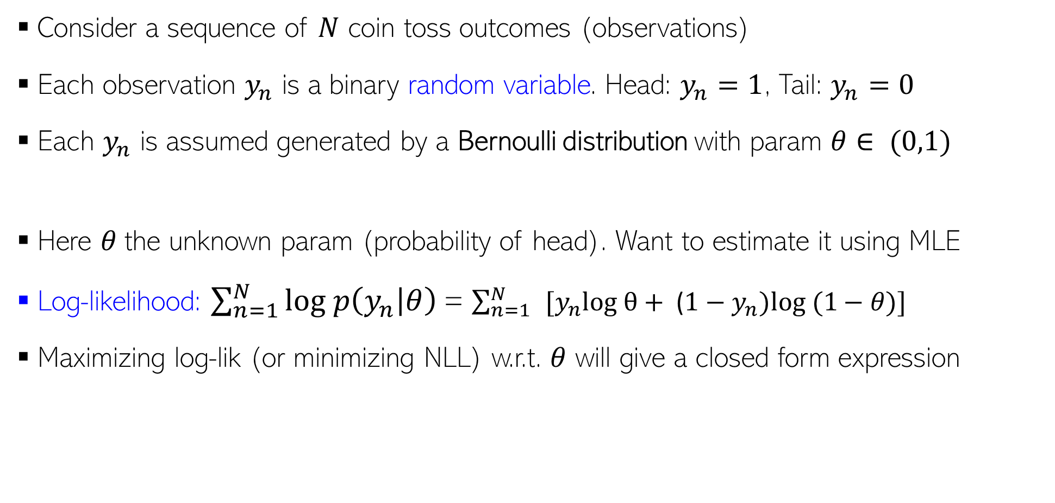
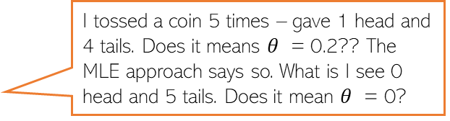

MLE: An Example
Consider a sequence of $N$ coin toss outcomes (observations)
Each observation $y_{n}$ is a binary random variable. Head: $y_{n}=1$, Tail: $y_{n}=0$
Each $y_{n}$ is assumed generated by a Bernoulli distribution with param $θ∈ (0,1)$
Here $θ$the unknown param (probability of head). Want to estimate it using MLE
Log-likelihood: $\sum_{n=1}^{N}{log p\left(y_{n} | θ\right) }$= $\sum_{n=1}^{N}{ }[y_{n}log θ+ \text{(}1−y_{n})log⁡ (1−θ)]$
Maximizing log-lik (or minimizing NLL) w.r.t. $θ$ will give a closed form expression
Probability of a head
$p\left(y_{n} | θ\right)=Bernoulli\left(y_{n} | θ\right)= θ^{y_{n}}$ ${(1−θ)}^{1−y_{n}}$
Take deriv. set it to zero and solve. Easy optimization
I tossed a coin 5 times – gave 1 head and 4 tails. Does it means $θ$ = 0.2?? The MLE approach says so. What is I see 0 head and 5 tails. Does it mean $θ$ = 0?
Thus MLE solution is simply the fraction of heads! ☺ Makes intuitive sense!
Indeed – if you want to trust MLE solution. But with small number of training observations, MLE may overfit and may not be reliable. We will soon see better alternatives that use prior distributions!
$$θ_{MLE}= \frac{\sum_{n=1}^{N}{y_{n}}}{N}$$

Slide 8
MLE and Its Shortcomings..
MLE finds parameter values s that make the observed data most probable
No provision to control overfitting (MLE is just like minimizing training loss)
How do we regularize probabilistic models in a principled way?
Also, MLE gives only a single “best” answer (“point estimate”)
.. and it may not be very reliable, especially when we have very little data
Desirable: Report a probability distribution over the learned params instead of point est
Prior distributions provide a nice way to accomplish such things!
Log-likelihood
Neg. log-likelihood (NLL)
$$θ_{MLE}= arg\max_{θ}\sum_{n=1}^{N}{log p\left(y_{n} | θ\right) }\text{= }arg\min_{θ}\sum_{n=1}^{N}{−log p\left(y_{n} | θ\right) }$$
This distribution can give us a sense about the uncertainty in the parameter estimate

Slide 9
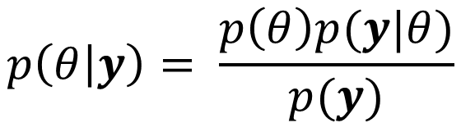





Priors
Before observing any data
Can specify our prior belief about likely param values via a prob. dist., e.g.,
Once we observe the data $y$, apply Bayes rule to update prior into posterior
Two ways now to report the answer:
Report the maxima (mode) of the posterior: $arg \max_{θ} p\left(θ | y\right)$
Report the full posterior (and its properties, e.g., mean, mode, variance, quantiles, etc)
This is a rather simplistic/contrived prior. ☺ Just to illustrate the basic idea. We will see more concrete examples of priors shortly. Also, the prior usually depends (assumed conditioned on) on some fixed/learnable hyperparameters (say some $α$and $β$ , and written as $p(θ|α,β)$
$$p(θ)$$
A possible prior for the coin bias estimation problem. The unknown $θ$is being treated as a random variable, not simply a fixed unknown as we treated it as in MLE
0
0.25
0.5
0.75
1
$$θ$$
Prior
Likelihood
Note: Marginal lik. is hard to compute in general as it requires a summation or integral which may not be easy (will briefly look at this in CS771, although will stay away going too deep in this course –CS772 does that in more detail)
$$p\left(θ | y\right)= \frac{p\left(θ\right)p(y|θ)}{p(y)}$$
Posterior
Marginal likelihood
Maximum-a-posteriori (MAP) estimation
Fully Bayesian inference

Slide 10


Posterior
Posterior distribution tells us how probable different parameter values are after we have observed some data
Height of posterior at each value gives the posterior probability of that value
Can think of the posterior as a “hybrid” obtained by combining information from the likelihood and the prior
$$p(θ|y)$$
More likely values
Less likely values
0
0.25
0.5
0.75
1
$$θ$$

Slide 11


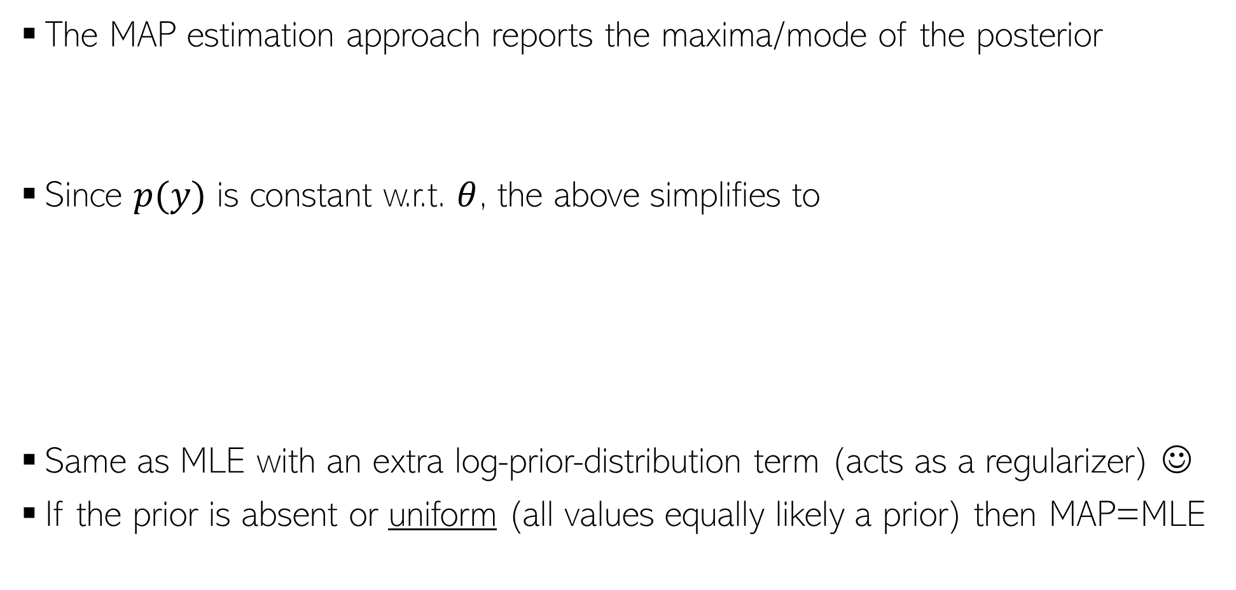

Maximum-a-Posteriori (MAP) Estimation
The MAP estimation approach reports the maxima/mode of the posterior
Since $p(y)$ is constant w.r.t. $θ$, the above simplifies to
Same as MLE with an extra log-prior-distribution term (acts as a regularizer) ☺
If the prior is absent or uniform (all values equally likely a prior) then MAP=MLE
$$θ_{MAP}=arg \max_{θ}p\left(θ | y\right)=arg\max_{θ}log p\left(θ | y\right)=arg\max_{θ}log \frac{p\left(θ\right)p(y|θ)}{p(y)}$$
$$θ_{MAP}=arg\max_{θ}[log p\left(y | θ\right)+ log p\left(θ\right)]$$
The NLL term acts like the training loss and the (negative) log-prior acts as regularizer. Keep in mind this analogy. ☺
$$=arg\min_{θ}[−log p\left(y | θ\right)− log p\left(θ\right)]$$
$$θ_{MAP} =arg\min_{θ}[NLL(θ)− log p\left(θ\right)]$$

Slide 12
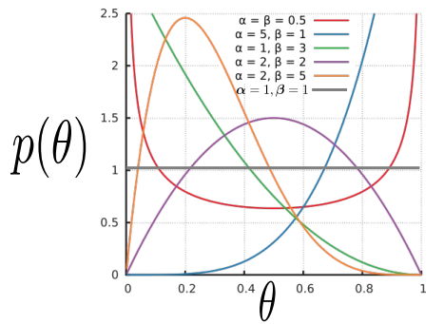
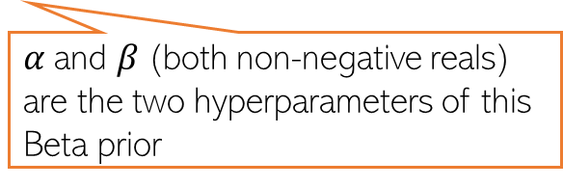
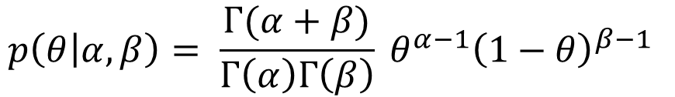


MAP Estimation: An Example
Let’s again consider the coin-toss problem (estimating the bias of the coin)
Each likelihood term is Bernoulli
Also need a prior since we want to do MAP estimation
Since $θ∈ (0,1)$, a reasonable choice of prior for $θ$would be Beta distribution
$$p\left(y_{n} | θ\right)=Bernoulli\left(y_{n} | θ\right)= θ^{y_{n}} {(1−θ)}^{1−y_{n}}$$
$$p\left(θ | α,β\right)= \frac{Γ(α+β)}{Γ\left(α\right)Γ\left(β\right)} θ^{α−1}{\left(1−θ\right)}^{β−1 }$$
The gamma function
$α$and $β$(both non-negative reals) are the two hyperparameters of this Beta prior
Using $α=1$and $β=1$will make the Beta prior a uniform prior
Can set these based on intuition, cross-validation, or even learn them

Slide 13
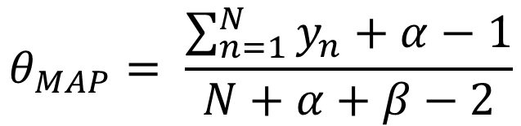
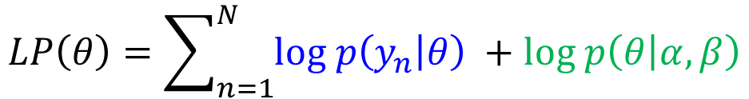
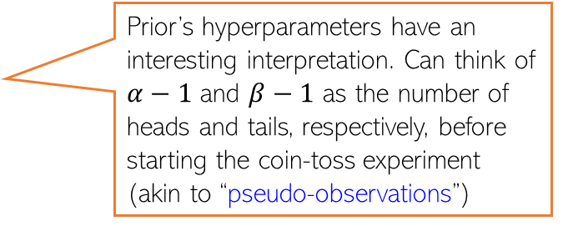

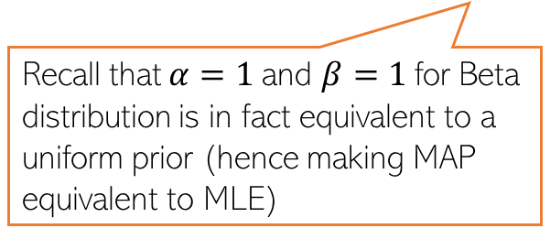

MAP Estimation: An Example (Contd)
The log posterior for the coin-toss model is log-lik + log-prior
Plugging in the expressions for Bernoulli and Beta and ignoring any terms that don’t depend on $θ$, the log posterior simplifies to
Maximizing the above log post. (or min. of its negative) w.r.t. 𝜃 gives
$$LP\left(θ\right)=\sum_{n=1}^{N}{log p\left(y_{n} | θ\right) }+log p\left(θ | α,β\right)$$
$$LP\left(θ\right)=\sum_{n=1}^{N}{\left[y_{n}log θ+\text{ (}1−y_{n}\right)log\left(1−θ\right)]+}\left(α−1\right)log θ+\left(β−1\right)log(1−θ)$$
Prior’s hyperparameters have an interesting interpretation. Can think of $α−1$ and $β−1$ as the number of heads and tails, respectively, before starting the coin-toss experiment (akin to “pseudo-observations”)
Using $α=1$and $β=1$gives us the same solution as MLE
$$θ_{MAP}= \frac{\sum_{n=1}^{N}{y_{n}+α−1}}{N+α+β−2}$$
Recall that $α=1$and $β=1$for Beta distribution is in fact equivalent to a uniform prior (hence making MAP equivalent to MLE)
Such interpretations of prior’s hyperparameters as being “pseudo-observations” exist for various other prior distributions as well (in particular, distributions belonging to “exponential family” of distributions

Slide 14
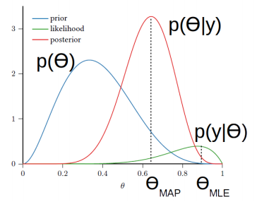
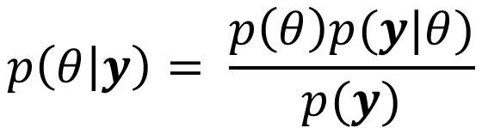

Fully Bayesian Inference
MLE/MAP only give us a point estimate of $θ$
If we want more than just a point estimate, we can compute the full posterior
Interesting fact to keep in mind: Note that the use of the prior is making the MLE solution move towards the prior (MAP solution is kind of a “compromise between MLE solution of the mode of the prior) ☺
MAP estimate is more robust than MLE (due to the regularization effect) but the estimate of uncertainty is missing in both approaches – both just return a single “optimal” solution by solving an optimization problem
Fully Bayesian inference
Computable analytically only when the prior and likelihood are “friends” with each other (i.e., they form a conjugate pair of distributions (distributions from exponential family have conjugate priors
$$p\left(θ | y\right)= \frac{p\left(θ\right)p(y|θ)}{p(y)}$$
In other cases, the posterior needs to be approximated (will see 1-2 such cases in this course; more detailed treatment in the advanced course on probabilistic modeling and inference)
An example: Bernoulli and Beta are conjugate. Will see some more such pairs

Slide 15
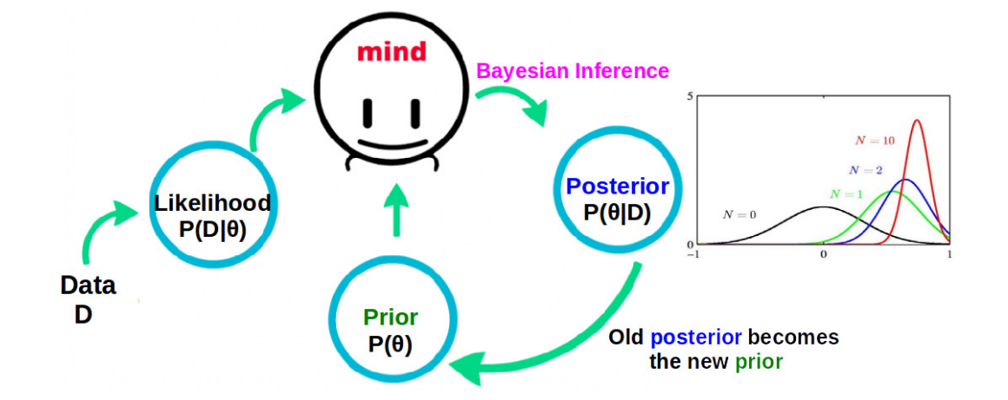

“Online” Nature of Bayesian Inference
Fully Bayesian inference fits naturally into an “online” learning setting
Our belief about $θ$ keeps getting updated as we see more and more data
Also, the posterior becomes more and more “concentrated” as the number of observations increases. For very large N, you may expect it to be peak around the MLE solution

Slide 16
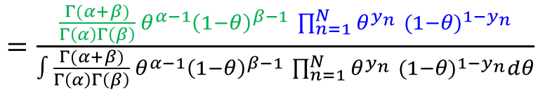
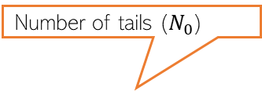
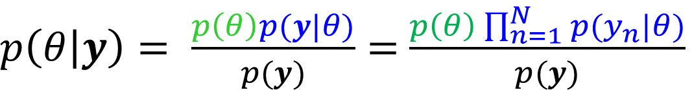
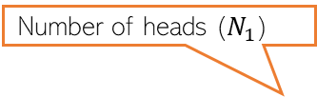

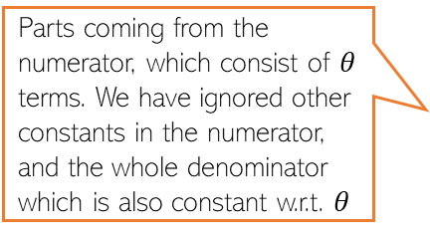


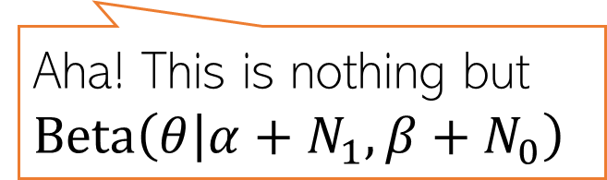
Fully Bayesian Inference: An Example
Posterior is the same distribution as the prior (both Beta), just with updated hyperparameters (property when likelihood and prior are conjugate to each other)
Also, if you get more observations, you can treat the current posterior as the new prior and obtain a new posterior using these extra observations
Let’s again consider the coin-toss problem
Bernoulli likelihood: $p\left(y_{n} | θ\right)=Bernoulli\left(y_{n} | θ\right)= θ^{y_{n}} {(1−θ)}^{1−y_{n}}$
Beta prior: $p\left(θ\right)=Beta\left(θ | α, β\right)= \frac{Γ(α+β)}{Γ\left(α\right)Γ\left(β\right)} θ^{α−1}{\left(1−θ\right)}^{β−1 }$
The posterior can be computed as
Number of heads ($N_{1}$)
Number of tails ($N_{0}$)
$$θ^{\sum_{n=1}^{N}{y_{n}}} {(1−θ)}^{N−\sum_{n=1}^{N}{y_{n}}}$$
$p\left(θ | y\right)= \frac{p\left(θ\right)p(y|θ)}{p(y)}=$ $\frac{p\left(θ\right)\prod_{n=1}^{N}{p(y_{n}|θ)}}{p(y)}$
$=\frac{\frac{Γ(α+β)}{Γ\left(α\right)Γ\left(β\right)} θ^{α−1}{\left(1−θ\right)}^{β−1 }\prod_{n=1}^{N}{θ^{y_{n}} {(1−θ)}^{1−y_{n}}}}{∫\frac{Γ(α+β)}{Γ\left(α\right)Γ\left(β\right)} θ^{α−1}{\left(1−θ\right)}^{β−1 }\prod_{n=1}^{N}{θ^{y_{n}} {(1−θ)}^{1−y_{n}}}dθ}$
Parts coming from the numerator, which consist of $θ$ terms. We have ignored other constants in the numerator, and the whole denominator which is also constant w.r.t. $θ$
This is the numerator integrated/marginalized over $θ :$ $p\left(y\right) =∫p\left(θ, y\right)dθ=∫p\left(θ\right)p\left(y | θ\right)dθ$
In general, hard but with conjugate pairs of prior and likelihood, we don’t need to compute this, as we will see in this example ☺
$∝θ^{α+N_{1}−1}{{\left(1−θ\right)}^{β+N_{0}−1}}^{ }$
Aha! This is nothing but $Beta\left(θ | α+N_{1}, β+N_{0}\right)$
This, of course, is not always possible but only in simple cases like this
Found the posterior just by simple inspection without having to calculate the constant of proportionality ☺

Slide 17
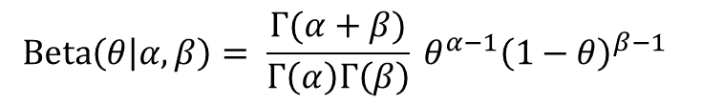

Conjugacy
Many pairs of distributions are conjugate to each other
Bernoulli (likelihood) + Beta (prior) ⇒ Beta posterior
Binomial (likelihood) + Beta (prior) ⇒ Beta posterior
Multinomial (likelihood) + Dirichlet (prior) ⇒ Dirichlet posterior
Poisson (likelihood) + Gamma (prior) ⇒ Gamma posterior
Gaussian (likelihood) + Gaussian (prior) ⇒ Gaussian posterior
and many other such pairs ..
Tip: If two distr are conjugate to each other, their functional forms are similar
Example: Bernoulli and Beta have the forms
This is why, when we multiply them while computing the posterior, the exponents get added and we get the same form for the posterior as the prior but with just updated hyperparameter. Also, we can identify the posterior and its hyperparameters simply by inspection
$$Bernoulli\left(y | θ\right)= θ^{y} {(1−θ)}^{1−y}$$
$$Beta\left(θ | α, β\right)= \frac{Γ(α+β)}{Γ\left(α\right)Γ\left(β\right)} θ^{α−1}{\left(1−θ\right)}^{β−1 }$$

Slide 18



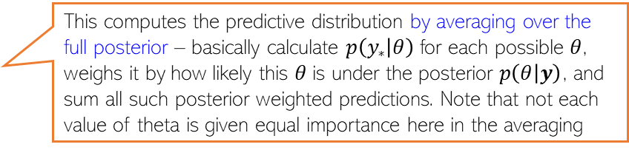



Probabilistic Models: Making Predictions
For example, PMF of the label of a new test input in classification
Having estimated $θ$, we can now use it to make predictions
Prediction entails computing the predictive distribution of a new observation, say $y_{∗}$
When doing MLE/MAP, we approximate the posterior $p(θ|y)$by a single point $θ_{opt}$
When doing fully Bayesian estimation, getting the predictive dist. will require computing
$$p\left(y_{∗} | y\right)=∫p\left(y_{∗},θ | y\right)dθ$$
Marginalizing over the unknown $θ$
$$=∫p\left(y_{∗} | θ, y\right)p(θ|y)dθ$$
Decomposing the joint using chain rule
Conditional distribution of the new observation, given past observations
$$=∫p\left(y_{∗} | θ\right)p(θ|y)dθ$$
Assuming i.i.d. data, given $θ$, $y_{∗}$ does not depend on $y$
$$p\left(y_{∗} | y\right)=∫p\left(y_{∗} | θ\right)p\left(θ | y\right)dθ≈p(y_{∗}|θ_{opt})$$
A “plug-in prediction” (simply plugged in the single best estimate we had)
This computes the predictive distribution by averaging over the full posterior – basically calculate $p\left(y_{∗} | θ\right)$ for each possible $θ$, weighs it by how likely this $θ$is under the posterior $p\left(θ | y\right)$, and sum all such posterior weighted predictions. Note that not each value of theta is given equal importance here in the averaging
$$p\left(y_{∗} | y\right)=∫p\left(y_{∗} | θ\right)p\left(θ | y\right)dθ$$
$$𝔼_{p\left(θ | y\right)}[p\left(y_{∗} | θ\right)]$$

Slide 19


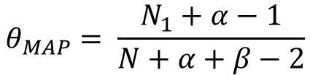
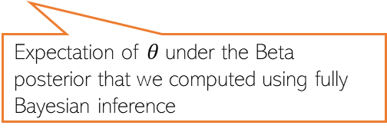

Probabilistic Models: Making Predictions (Example)
For coin-toss example, let’s compute probability of the ${\left(N+1\right)}^{th}$toss showing head
This can be done using the MLE/MAP estimate, or using the full posterior
Thus for this example (where observations are assumed to come from a Bernoulli)
$$θ_{MLE}= \frac{N_{1}}{N}$$
$$θ_{MAP}= \frac{N_{1}+α−1}{N+α+β−2}$$
$$p\left(θ | y\right)= Beta\left(θ | α+N_{1}, β+N_{0}\right)$$
Again, keep in mind that the posterior weighted averaged prediction used in the fully Bayesian case would usually not be as simple to compute as it was in this case. We will look at some hard cases later
Expectation of $θ$under the Beta posterior that we computed using fully Bayesian inference

Slide 20
Probabilistic Modeling: A Summary
Likelihood corresponds to a loss function; prior corresponds to a regularizer
Can choose likelihoods and priors based on the nature/property of data/parameters
MLE estimation = unregularized loss function minimization
MAP estimation = regularized loss function minimization
Allows us to do fully Bayesian learning (learning the full distribution of the parameters)
Makes robust predictions by posterior averaging (rather than using point estimate)
Many other benefits, such as
Estimate of confidence in the model’s prediction (useful for doing Active Learning)
Can do automatic model selection, hyperparameter estimation, handle missing data, etc.
Formulate latent variable models
.. and many other benefits (a proper treatment deserves a separate course, but we will see some of these in this course, too)

